Slide 1

Airbnb Room Classifications
Group 16
MBC 638 Project
Rahul Jairaj
June Lei
Xueqing Wang
Jeet Kamal Ganatra
Anukrati Shrivastava
1

Slide 2

Part A
DESCRIPTIVE ANALYSIS OF VARIABLES

Slide 3
“Air-bed and breakfast” Airbnb is an online service which provides lodging to tourists without the company owning any real-estate. Plan for the data is to predict whether a listing is budget or luxury listing.
INTRODUCTION

Slide 4
Data Collection and Population Description of Variables Descriptive analysis for: 1. Airbnb properties in the U.S.A. 2. Cities with maximum booking 3. Customer review Score analysis on basis of number of reviews and cities 4.Timeline for Average Review Score 5. Review score distribution among classes 6. Properties on the basis of owner identity verification 7. Review scores for room types on the basis of cities
OBJECTIVES FOR PART - A

Slide 5

DATA COLLECTION
This data was collected with the help of TAs from iSchool’s Data Analytics class.
They combined different streams of data from Kaggle and http://insideairbnb.com/get-the-data.html
No Surveying was done.

Slide 6
DESCRIPTION OF VARIABLES
Variable Name | Detailed Description | Unit of Measurement | Examples
id | Serial Number of the listing. | Numeric | 65659, 2157
property_type | The type of property the lisiting is. | Categorical | Apartment, House
room_type | The type of room rented out. | Categorical | Entire Home/apt, Private room
amenities | Lists out all the amenities that are available in the room. | Categorical | {Internet,"Wireless Internet",Kitchen,"Pets allowed","Family/kid friendly",Washer,Dryer,"First aid kit","Fire extinguisher",Essentials}
accommodates | The number of people that this listing accommodates. | Numeric | 2, 4, 1
bathrooms | The number of bathrooms in this listing. | Numeric | 1, 2, 6
bed_type | The type of bedding in this listing. | Categorical | Airbed, Pull-out-sofa
cancelation_policy | The cancellation policy on the listing. | Categorical | flexible, strict
cleaning_fee | Whether a cleaning fee will be accrued or not. | Categorical | TRUE, FALSE

Slide 7
Variable Name | Detailed Description | Unit of Measurement | Examples
city | The city in which the listing is located in | Categorical | NYC, Boston
description | The description of the listing given on the website/app | Categorical (Text) | Clean, calm and bright one
first_review | When the listing was first reviewed | Categorical (Date) | 8/1/2017, 10/10/2014
host_has_profile_pic | Whether or not the host has a profile picture | Categorical | t, f
host_response_rate | The percentage of times the host has responded to previous queries | Numeric (Percentage) | 87%, 100%
host_since | The date from which the host has been listing a property on Airbnb | Categorical (Date) | 1/23/2016, 9/30/2013
instant_bookable | Whether the listing is instantly bookable via the site/app or not | Categorical | t, f
last_review | When the last review on that listing has been | Categorical (Date) | 9/17/2017, 8/15/2014
latitude | Latitude measurement of the listing | Numeric | 40.70718752, 34.07368651

Slide 8
Variable Name | Detailed Description | Unit of Measurement | Examples
longitude | Longitude measurement of the listing | Numeric | -118.265252, -73.98952737
name | Name of the listing | Categorical | Big PRIVATE room for a group! Hollywood, central, Charming Upper East side apartment
neighbourhood | The listing’s neighborhood | Categorical | Harlem, Glendale
number_of_reviews | The number of reviews on the listing | Numeric | 19, 9
review_scores_rating | The rating for the listing | Numeric | 83, 100
zipcode | The zipcode of the listing | Numeric | 10021, 94114
bedrooms | The number of bedrooms in the listing | Numeric | 0, 3
beds | The number of beds in the listing | Numeric | 1, 2
Class | The category of the listing in the app/website | Categorical | Budget, Luxury

Slide 9

POPULATION OF DATA
Major cities in the United States -Boston, Chicago, DC, NYC, LA and SF.
Not full population and is a sample.
Cleaned (30k) blank rows.
Remaining 42k data points seem like a random sample from original - cleaned dataset can be classified as representative of the population of interest.
Notes:
Our population of interest is the Airbnb listings from major cities in the United States.
This is definitely a sample and not a full population as we are considering how some factors affect review ratings in only Boston, Chicago, DC, NYC, LA and SF.
Additionally, we removed about half (30k) the rows in data due to blank values, so even in the sample space of these cities, this data seems like a random sample.
So, our final cleaned dataset can be classified as a representative of the population of interest.

Slide 10
Descriptive Analysis

Slide 11
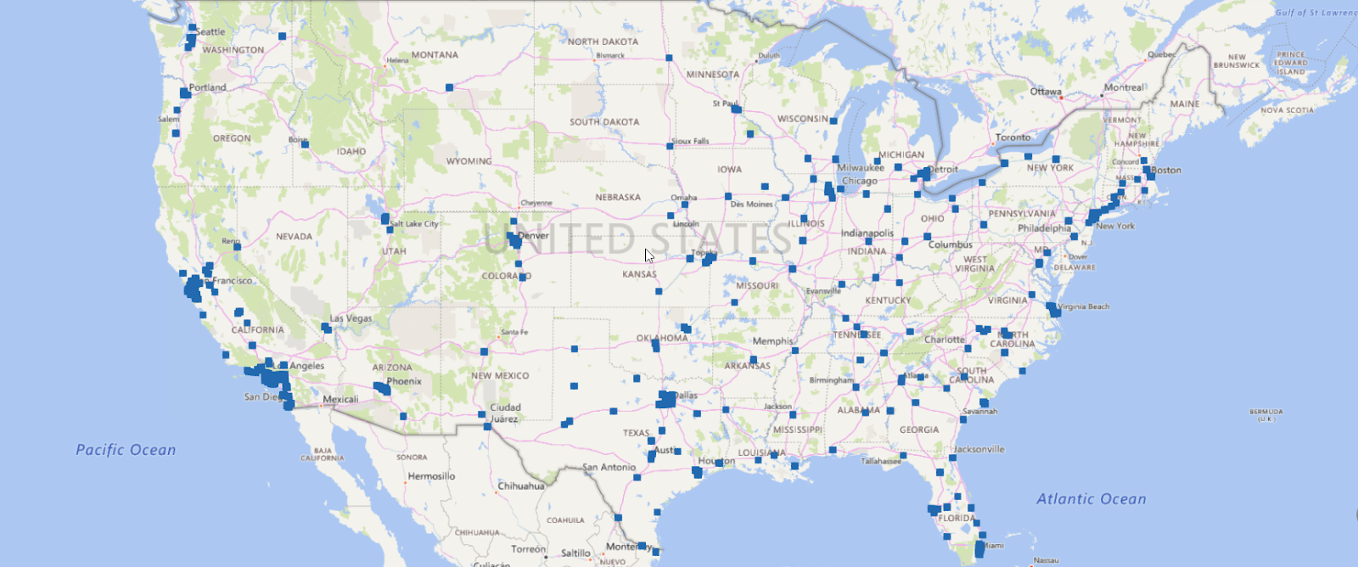
1. Airbnb properties in the U.S.A.

Slide 12
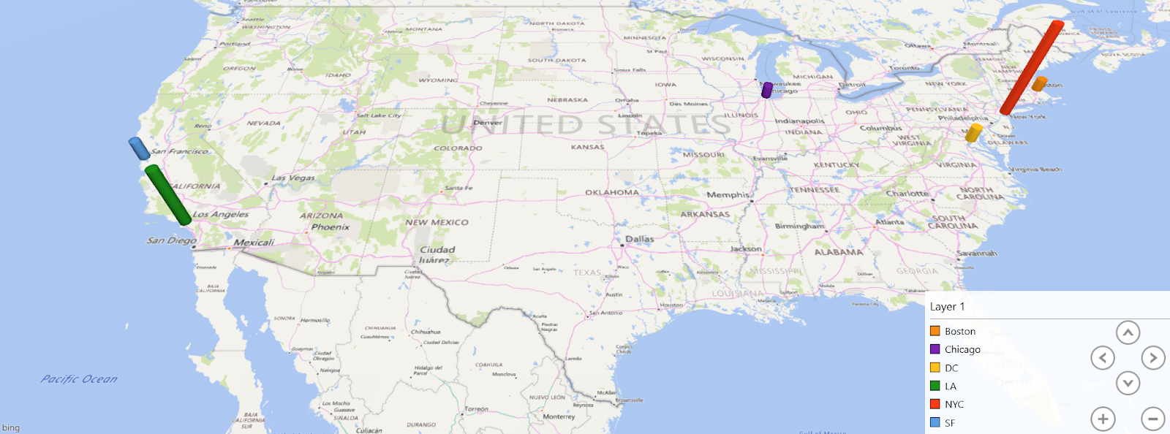
2.Cities of listings with highest reviews

Slide 13
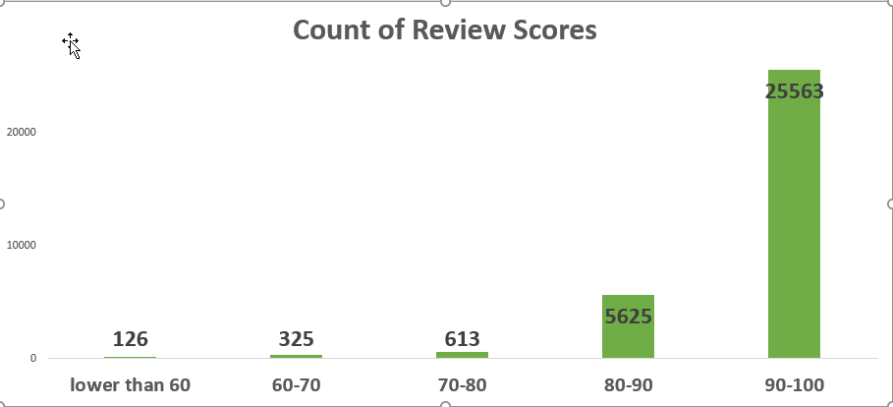
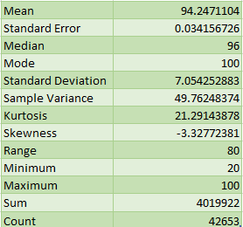
3. Customer review score analysis
Count of the scores based on property types in different cities
Most of the reviews in the data have a score of 90 and above

Slide 14

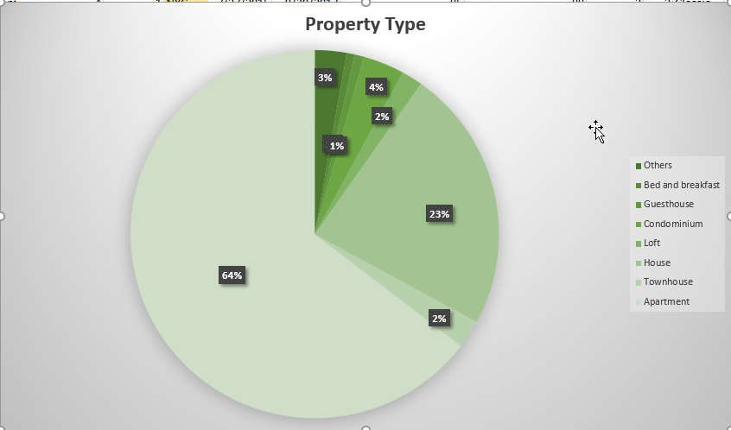
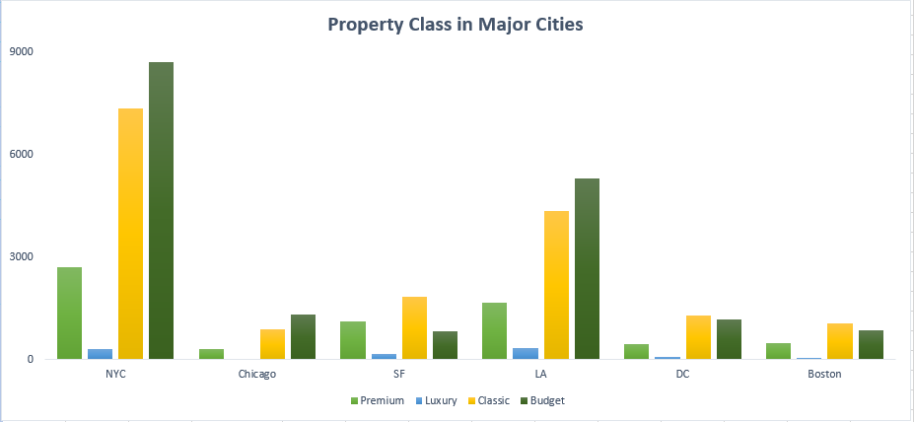
Count of the scores based on property types in different cities
NYC has the most number of properties reviewed by customers, followed by LA and SF.

Slide 15
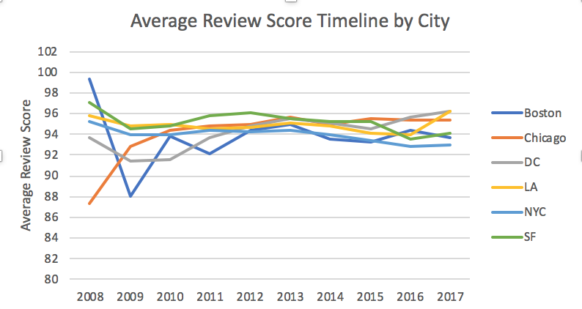
4. Timeline for the average review SCORE
Average scores range from 92-98
From 2008-2011, DC received the lowest rating.
Anomaly in scores for Boston in 2008-2009 and Chicago in 2008
Calculating Z score, we find these are possible outliers:
Notes:
Airbnb was just started, people did not have experience and were new to this field.

Slide 16
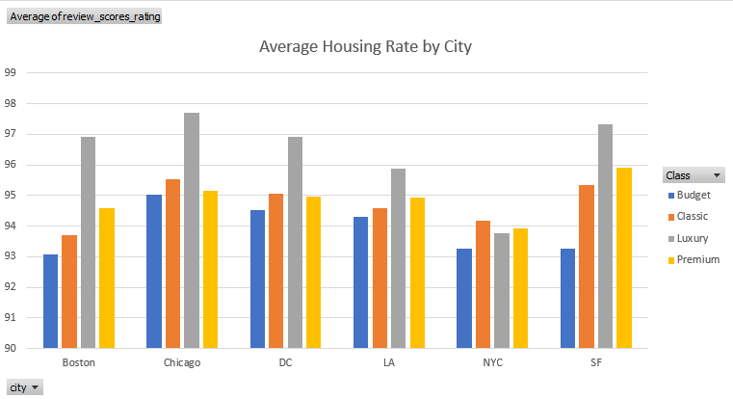


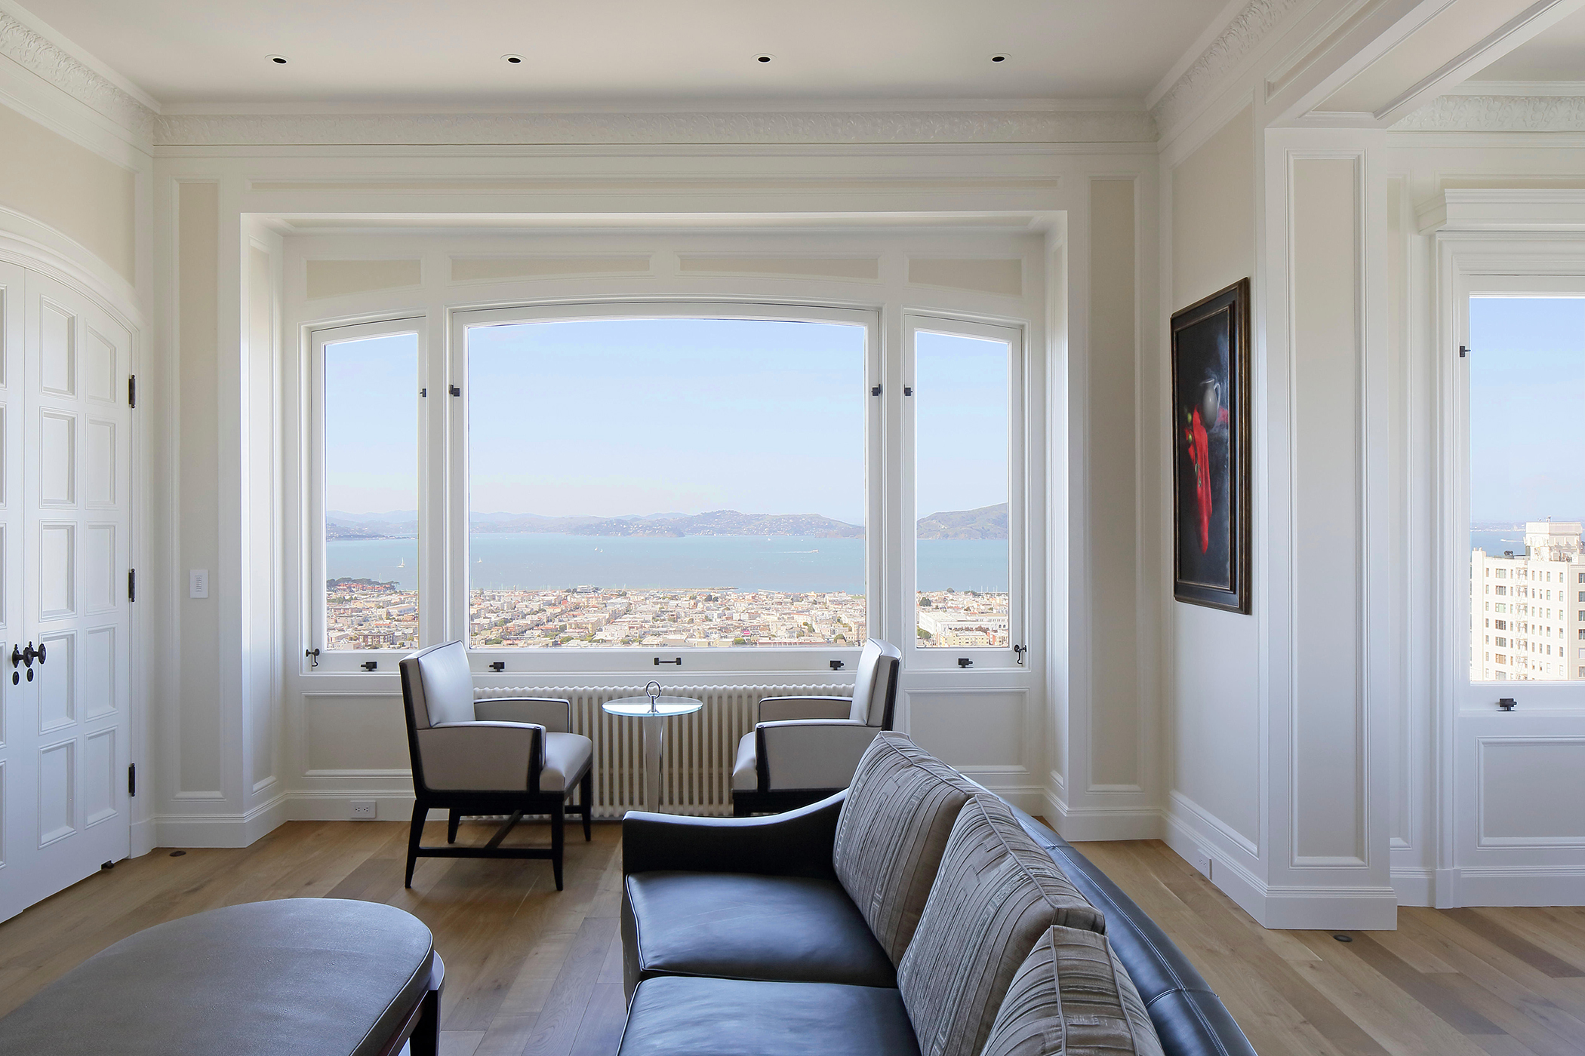
5.Review score distribution in cities by different room class
Luxury rooms receive the highest review scores followed by premium except for New York.
Budget rooms have received the lowest review scores.
All types of properties in New York have received lower ratings on average, than other cities.
Average Review Score of Different Classes

Slide 17
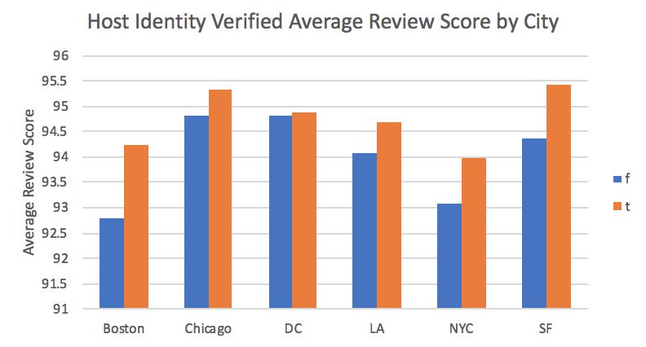




6. Average reviews based on identification of host
Properties where host have shared their identity have received better rating than the ones where host is unidentified.
Boston, NYC and SF have significant difference in their ratings for this case.

Slide 18
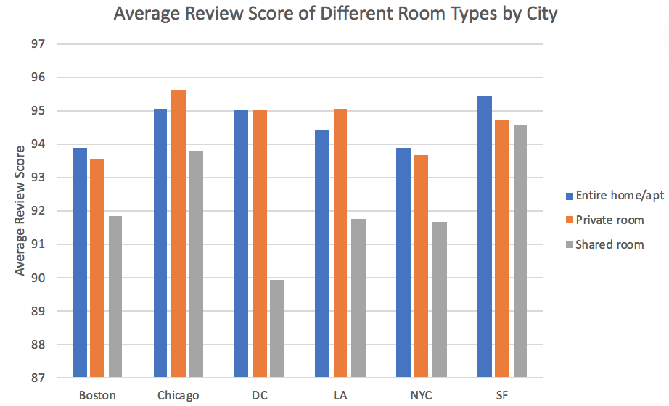

7. AVERAGE REVIEW SCORE OF ROOM TYPES BY CITY
SF’s average review scores are almost the same between the three.
In other cities, especially DC and LA, the shared room gets much lower scores than entire home and private room.

Slide 19
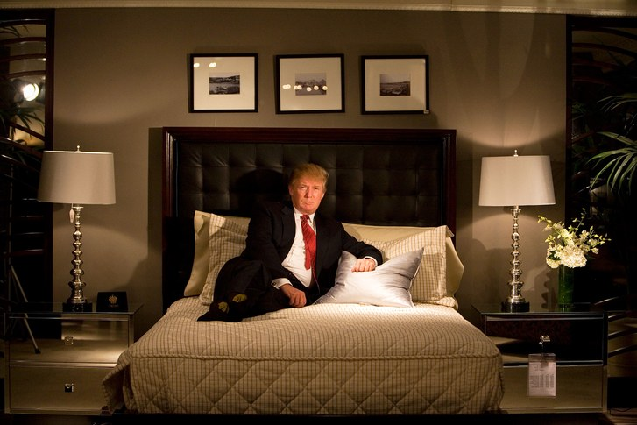



Inferences
Most properties have a rating of 90 or above.
Maximum number of properties are apartment type, followed by house type.
Luxury class rooms have received highest reviews on average.
Properties were the host has identified themselves have received more reviews.
NYC has a lower average review score amongst all properties, compared to other major cities.

Slide 20
ANALYSIS OF ASSOCIATION BETWEEN VARIABLES
Part B

Slide 21
1. Correlation Analysing relation between variables and room classification 2. Multiple Regression Determining which variables affect room categorization 3. Hypothesis Testing Cross-validating if the variables are significant enough to support our results 4. Prediction/Forecasting 5. Conclusions
OBJECTIVES

Slide 22




Choosing dependent variables
Predicting the categorization of class of rooms seems interesting.
Help Airbnb to filter the listing based on user preferences, in the website.
Help the management to understand which factors affect the class of a listing.
Notes:
We initially planned to predict “review_scores_rating” based on various explanatory variables.
With more digging, we felt predicting the categorization of class of rooms will be more interesting. Specifically if the listing is a regular listing (“Classic” or “Budget”) or a luxury listing (“Luxury” or “Premium”).
The thought process behind choosing this our dependent variable as we believe this could help Airbnb to filter the listing based on user preferences.
This could also help the management to understand which factors affect the class of a listing.

Slide 23
Choosing explanatory variables
Decided to choose the following variables:
Variables | Description
Room Type | Luxury listings could be more likely to be homes rather than private rooms
Amenities | Luxury listings could have more amenities than budget ones
Accommodates | A lot of full homes are listed as budget which would have a large accommodates number
Bed Type | Budget listings could have pull-out couches as beds, while luxury ones might have more expensive options
Cancellation Policy | A lot of budget listings have flexible cancellation policies due to the dynamic and fast-paced nature of the bookings, we assume
Host Identity Verified | We assume that budget listings may not necessarily be verified all the time, but that might not be the case for premium listings

Slide 24
Choosing EXPLANATORY variables
Variables | Description
Instant Booking | Again due to fast-paced nature of the business for budget listings, we expect that they are more likely to have instant booking options
Latitude | Latitude, Longitude could determine certain neighbourhoods which may be telling us how expensive the listing may be
Longitude
Number of Reviews | Budget listings could have more reviews purely based on the number of people who have stayed at the properties
Review Score Rating | We are not yet sure on how this contribute, we would determine that with correlation between the score and class variable
Bedrooms | Luxury listings could have more bedrooms in their largest listings than budget listings
Beds | Keeping the number of bedrooms constant, we think having more beds points to listing being budget

Slide 25
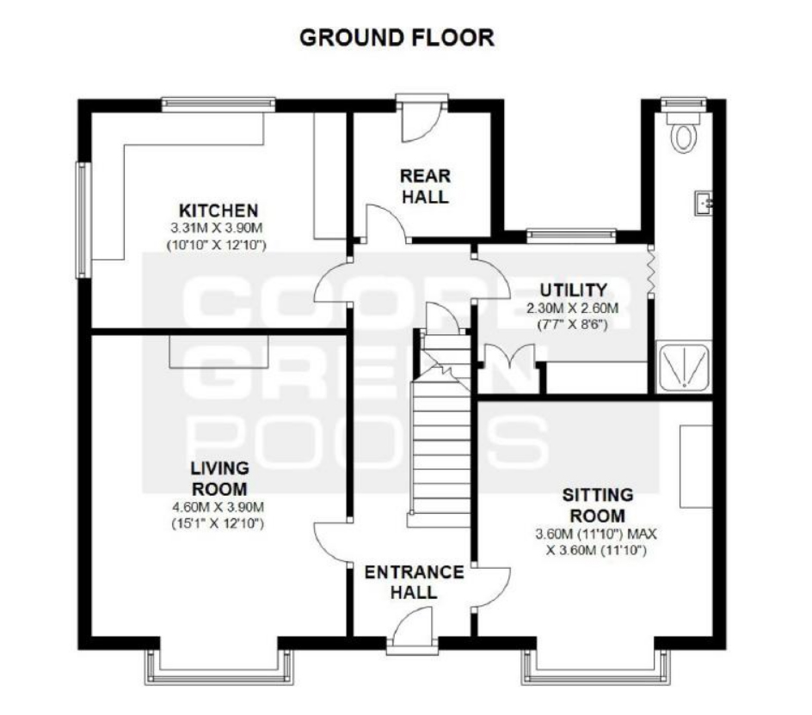

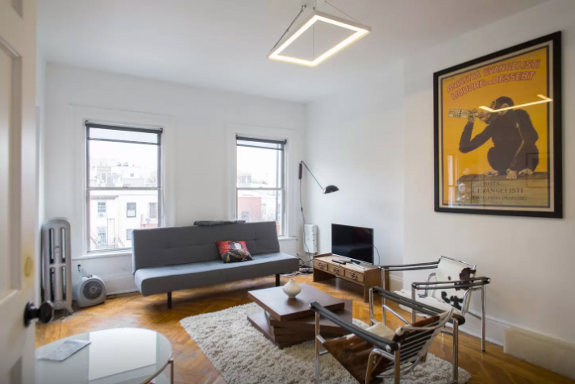
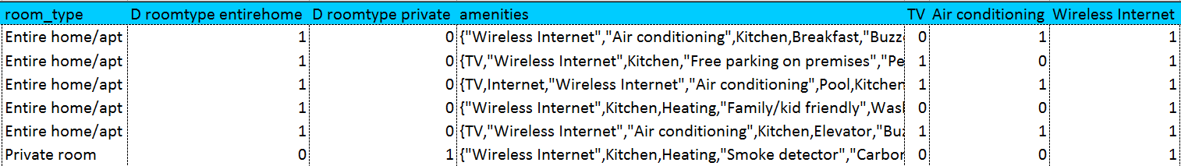
Choosing EXPLANATORY variables
“instant_bookable” & “room_type” converted to Dummy variables.
Splitting the “amenities” column into dummy variables.
We also wanted to observe the dependence of “accommodates” and “bedrooms” with each other as well as with “Class”, so we made an interaction variable for it.
Notes:
In order to use categorical variables like “instant_bookable” and “room_type”, we convert them into Dummy variables.
Additionally, for splitting the “amenities” column into dummy variables, we use the IF, ISNUMBER and SEARCH functions.
We also wanted to observe the dependence of “accommodates” and “bedrooms” with each other as well as with “Class”, so we made an interaction variable for it.

Slide 26

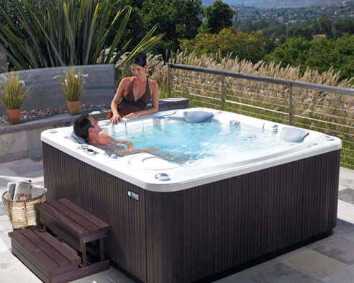
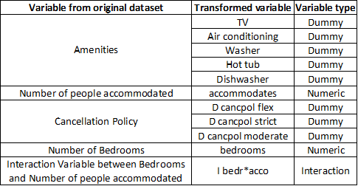
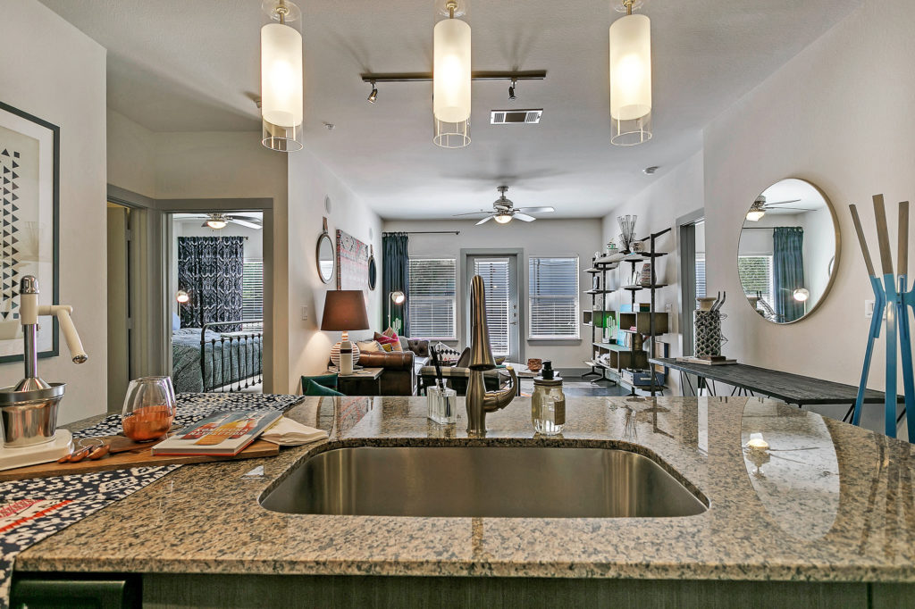

Choosing 5 DEPENDENT variables
We decided on the following variables for our model:

Slide 27
Predictions on explanatory variables
“amenities” - positive relationship. Budget listings are less likely to have high end amenities like “Hot tub”.
“accommodates”- negative relationship. Most budget listings are probably shared rooms with multiple beds, which can accommodate a lot of people.
“cancellation policy”. Strict – positive relationship. Due to the vast number of budget options, to remain competitive, they would have to offer flexible cancellation policies.
Notes:
“amenities” - We expect a positive relationship between amenities and luxury listings. Budget listings are less likely to have high end amenities like “Hot tub”.
“accommodates”- We expect most of the budget listings to be rooms with multiple beds, which can accommodate a lot of people. So, we feel that there should be a strong negative correlation to the budget variable.
“cancellation policy”- Due to the vast amount of budget listings to have a flexible cancellation policy. Due to the vast amount of budget options, in order to remain competitive and distinguish themselves, they would have to offer flexible cancellation policies.

Slide 28
Predictions on explanatory variables
“number of bedrooms” – positive relationship. High end listings may include penthouses, or suites with multiple bedrooms.
“number of bedrooms * number of people accommodated” - accommodated probably has a negative, while number of bedrooms has a positive one against class. Overall, we feel this would be negative.
Notes:
“number of bedrooms” - High end listings may include penthouses, or suites which may have multiple bedrooms available for use. Budget logically would offer only single bedrooms. So, we think there should be a positive relationship.
“number of bedrooms * number of people accommodated” - we feel accommodated has a negative relationship with the listing being luxury, while number of bedrooms has a positive one. The net product, we feel could have a negative correlation, because the accommodates values have in general a higher magnitude than number of bedrooms. So, we feel that it’s effect will be overpowering in the resultant interaction variable.

Slide 29
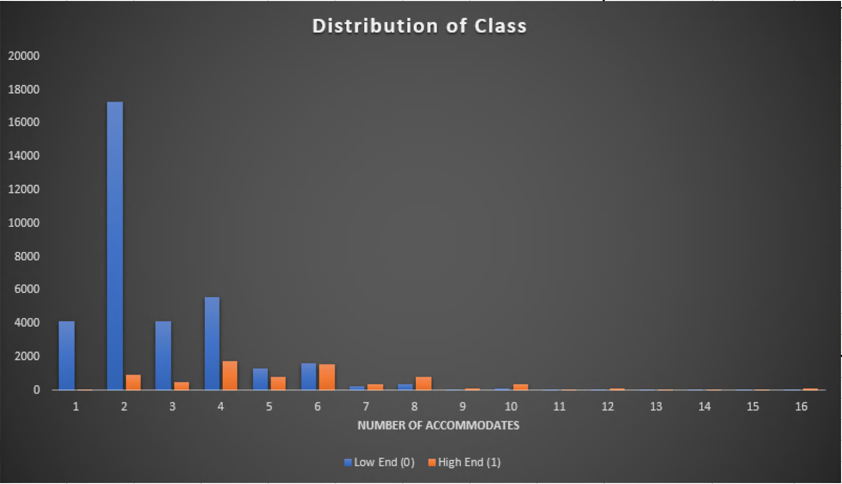
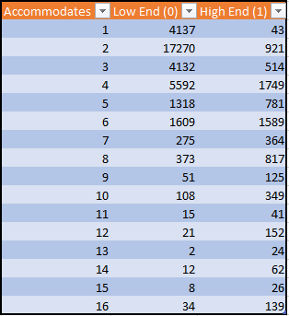
Distribution of Class & Number of Accommodates
X-axis is no. of people accommodated, Y-axis is the no. of Airbnb houses
As dependent variable Class is categorical, bar graph is better.
Notes:
X-axis is number of accommodates i.e. the number of people that can be accommodated
Y-axis is the number of Airbnb houses
Bar graph is a better option comparing to scatter plot because the dependent variable Class (Low end being 0, High end being 1) is categorical variable and represented by dummy variable.

Slide 30
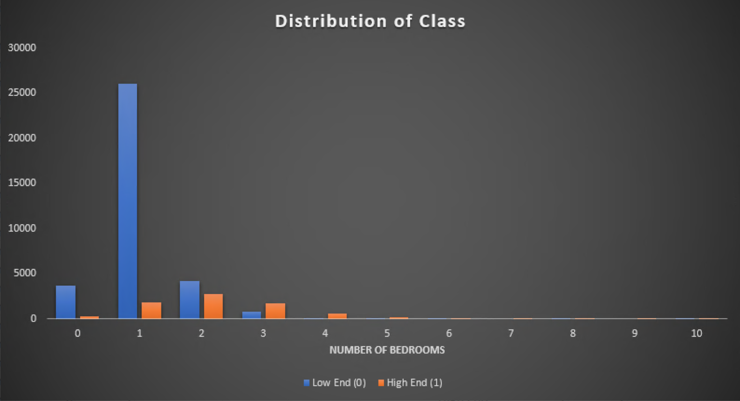
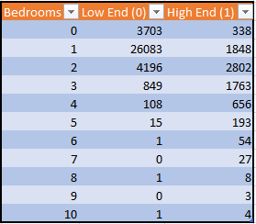
Distribution of Class & Number of Bedrooms
X-axis is number of bedrooms
Y-axis is the number of Airbnb houses

Slide 31
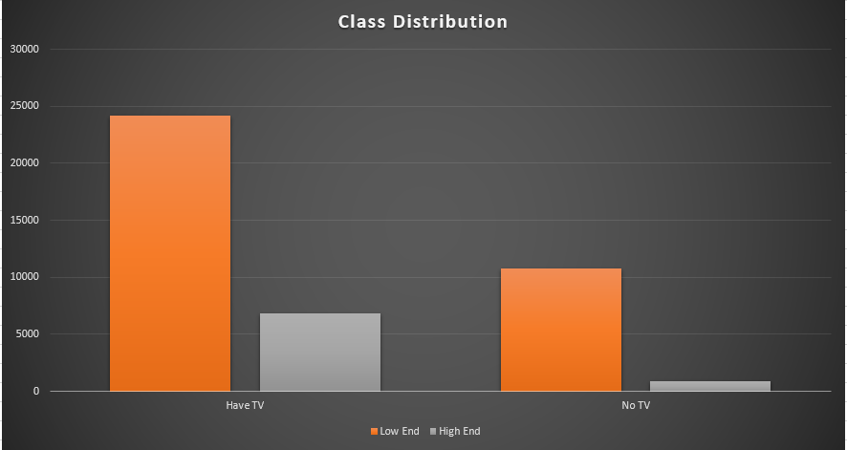
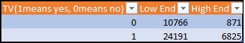
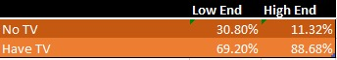
Distribution of Class & TV
X-axis is number of bedrooms
Y-axis is the number of Airbnb houses

Slide 32
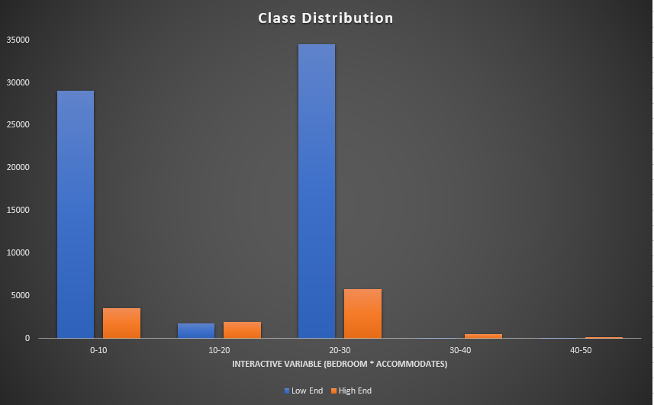
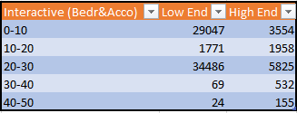
Distribution of Class & Interactive Variables (Bedrooms * Accommodates)
X-axis is number of bedrooms
Y-axis is the number of Airbnb houses

Slide 33
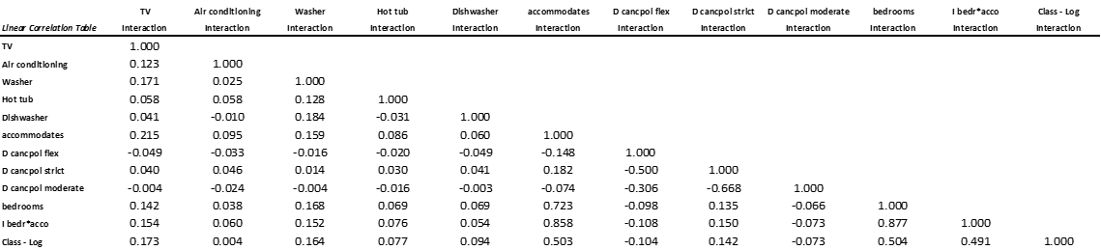
Correlation Analysis
The following is the result of correlation analysis conducted with dependent and independent variables selected previously.

Slide 34
Comparison of Correlation and Predictions
“amenities” - as expected.
“accommodates” - unexpectedly strongly positive correlation. Could be due to luxury suites and luxury private homes having the ability to house many people at once.
“cancellation policy” – as expected.
“bedrooms” - as expected.
“bedrooms * accommodates” interaction variable – unexpectedly strong positive. Because both accommodates and bedrooms being positively and relatively strongly correlated to class being luxury.
Notes:
“amenities” - as expected, there is a positive correlation. What was unexpected is that “HotTub” is only weakly correlated to luxury listings. This could be due to not many luxury listings valuing it as a necessity.
“accommodates” - is unexpectedly strongly positively correlated to luxury class listings. This could be due to luxury suites and luxury private homes having the ability to house many people at once.
“cancellation policy” - strict cancellation policies have a positive correlation to the class being luxury, which goes along with our assumption that budget listings are likely to have flexible policies.
“bedrooms” - are shown to have a strong positive correlation to class being luxury, which supports our assumption of high end penthouses or suites having multiple bedrooms for use.
“bedrooms * accommodates” interaction variable - This is also shown to have a relatively strong positive correlation to class being luxury. This can be attributed to both accommodates and bedrooms being positively and relatively strongly correlated to class being luxury. This was different from our prediction, as we assumed accommodates to be negatively correlated while bedrooms would be positively correlated.

Slide 35
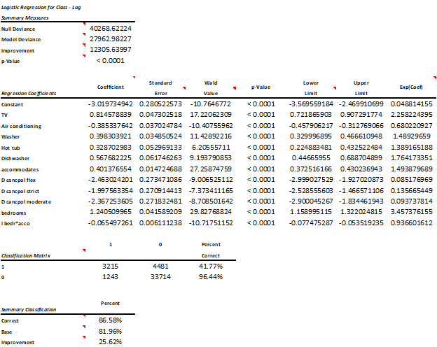
Logistic Regression Analysis
Using the 5 previously mentioned variables as explanatory, we perform a Logistic regression to predict the Class of the listing.
Notes:
P values are all < 0.001

Slide 36
Logistic Regression Analysis
The coefficients represent the respective variables’ contribution to the logit.
The more positive the logit, the more likely it is that the listing is luxury.
Notes:
The more positive the logit, the more likely it is that the listing is luxury, and inversely the more negative it is, the more likely that the listing is budget.

Slide 37
Logistic Regression Analysis
Constant -3.02 suggests a general skew in the number of budget listings as opposed to luxury.
In alignment with the sheer number of budget listings (34,957) observed in the classification matrix vs the luxury listings (7,696).

Slide 38
Logistic Regression Analysis: AMENITIES
TV, Washer, Hot Tub and Dishwasher all have positive coefficients and relationship to luxury.
AC had a negative coefficient - commonly widespread that having it was tantamount to the listing being budget.
TV had the highest positive coefficient of 0.81, - listings with TVs make it much more likely for it to be luxury - which is strange.
Notes:
Among the amenities, TV, Washer, Hot Tub and Dishwasher all have positive coefficients indicating that having these amenities would make it so that the listing is likely luxury.
Air conditioning had a negative coefficient, meaning that it was so commonly widespread that having it was tantamount to the listing being budget.
TV had the highest positive coefficient of 0.81, implying that listings with TVs make it much more likely for it to be luxury - which is a strange result.

Slide 39
Logistic Regression Analysis: Amenities
If a TV exists in a listing, it increases the logit of class being luxury by 0.81.
If a AC exists in a listing, it decreases the logit of class being luxury by 0.39.
If a Washer exists in a listing, it increases the logit of class being luxury by 0.40.
If a Hot Tub exists in a listing, it increases the logit of class being luxury by 0.33.
If a Dishwasher exists in a listing, it increases the logit of class being luxury by 0.57.

Slide 40
Logistic Regression Analysis
“Accommodates” - decent positive coefficient of 0.40 - listings that can accommodate more people are more likely to be luxury.
The cancellation policy dummy variables strong negative relationships given their coefficients (around -2 to -2.46) - This can mean that having a strict policy would tend the listing to be more luxurious.
Notes:
“Accommodates” has a decent positive coefficient of 0.40, meaning listings that can accommodate more people are more likely to be luxury, the same conclusion as from the correlation analysis.
The cancellation policy dummy variables have very strong negative relationships given their coefficients (around -2 to -2.46) - the more flexible the policy, the more negative it is. This can mean that having a strict policy would tend the listing to be more luxurious - inline with our predictions and correlation analysis.

Slide 41
Logistic Regression Analysis : ACCOMMODATES & Cancellation
If the number of people accommodated increases by 1, the logit increases by 0.40.
If the cancellation policy is:
flexible, then the logit for class being luxury decreases by 2.46
moderate, then the logit for class being luxury decreases by 2.37
strict, then the logit for the class being luxury decreases by 2.00

Slide 42
Logistic Regression Analysis : Bedrooms
Bedrooms have the highest positive coefficient of 1.24.
For every bedroom more in a listing, the logit for class being luxury increases by 1.24.
Notes:
Bedrooms have the highest positive coefficient of 1.24.
For every bedroom more in a listing, the logit for class being luxury increases by 1.24.
This variable has a chance to be the largest influencer in predicting class.
We say this, since this variable can take values from 0 to 10, which is much higher than any other variable apart from accommodates. Since accommodates has such a low coefficient, we can confidently declare that number of bedrooms is the biggest influencer.

Slide 43
Logistic Regression Analysis : Interaction (Accommodates*Bedrooms)
The interaction variable has a coefficient of -0.07.
This means that for every 1
Bedroom more, the number accommodated would contribute to the logit for luxury class 0.07 less.
Person accommodated more, bedroom would contribute to logit for luxury class 0.07 less.
Notes:
The interaction variable has a coefficient of -0.07.
This means that for every 1
Bedroom more, the number accommodated would contribute to the logit for luxury class 0.07 less.
Person accommodated more, bedroom would contribute to logit for luxury class 0.07 less.
We’re able to draw this conclusion by holding one constant and varying the other. This is made easier as both variables are discrete.

Slide 44
Hypothesis Test : Cancellation
To test if cancellation is a significant factor for determining the categorization of the class with a 99% confidence interval.
Test
Cancellation is not significant factor in determining the categorization of the class.
Ho
Ha
Cancellation is a significant factor in determining the categorization of the class.
Alpha = 0.01 (1-0.99) ; P value from regression: <0.0001 (flex, strict, moderate)
alpha
Since p value is less than Alpha, reject Null Hypothesis at 99% confidence
p<alpha
Hence, we reject the null hypothesis and concluded that cancellation is an important factor in determining the categorization of the class.
Result
Notes:
To test if cancellation is a significant factor for determining the categorization of the class with a 99% confidence interval.
Null Hypothesis (Ho): Cancellation is not significant factor in determining the categorization of the class.
Alternative Hypothesis (Ha): Cancellation is a significant factor in determining the categorization of the class.
Alpha = 0.01 (1-0.99) ; P value from regression: <0.0001 (flex, strict, moderate)
Since p value is less than Alpha, reject Null Hypothesis at 99% confidence
Hence, we reject the null hypothesis and concluded that cancellation is an important factor in determining the categorization of the class. All of the cancellation policies are significant for categorization of the class.

Slide 45
Hypothesis Test : TV
To test if having a TV is a significant factor for determining the categorization of the class with a 95% confidence interval.
Test
Having a TV is not significant factor in determining the categorization of the class.
Ho
Ha
Having a TV is a significant factor in determining the categorization of the class.
Alpha = 0.05 (1-0.95); P value from regression: <0.0001
alpha
Since p value is less than Alpha, reject Null Hypothesis at 95% confidence.
p<alpha
Hence, we reject the null hypothesis and concluded that having a TV is an important factor in determining the categorization of the class.
Result
Notes:
To test if having a TV is a significant factor for determining the categorization of the class with a 95% confidence interval.
Null Hypothesis (Ho): Having a TV is not significant factor in determining the categorization of the class.
Alternative Hypothesis (Ha): Having a TV is a significant factor in determining the categorization of the class.
Alpha = 0.05 (1-0.95); P value from regression: <0.0001
Since p value is less than Alpha, reject Null Hypothesis at 95% confidence.
Hence, we reject the null hypothesis and concluded that having a TV is an important factor in determining the categorization of the class.

Slide 46
Model Evaluation
We’ve obtained an overall accuracy of 86.58%.
The regression results were very good for budget listings (96.44%), but not very good for luxury (41.77%).

Slide 47
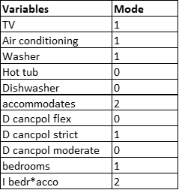
Predictions
We’re interested in finding out what class a listing from Airbnb falls under.
Choose values for the independent variables that most commonly occur in the dataset (mode):
Based on the large negative constant from the regression analysis, we predict that this will be a budget listing.

Slide 48
Forecasting
On substituting these values in the regression formula, we find the logit (z) as -2.28.
Calculating the probability of the listing being luxury, from the logit, we find it as 0.09.
So, our prediction that the listing is budget is correct.

Slide 49
Recommendations AND CONCLUSIONS
NYC has a lower average score for listings than other major cities – efforts should be made to improve the quality of the listings there.
TV, Air conditioning, Washer, Hot tub, Dish washer, Accommodates, bedrooms are significant factors for determining the categorization of class by the regression model, which has 86.58% of accuracy.
The regression results were very good for budget listings (96.44%), but not very good for luxury (41.77%). Having more data could help the model learn better to make more accurate predictions for luxury listings.
Bedroom can be the biggest influencer in determining the categorization of class, since it has a high coefficient (1.24) and can take values from 0 to 10. So, if Airbnb is looking to expand luxury listings, the first thing they should notice is the number of bedrooms, before the amenities.

Slide 50
Recommendations AND CONCLUSIONS
Airbnb app developers, clients, competitors like Expedia will benefit from this information.
App developers can rely on this model to filter listings to show on the Airbnb mobile and web app.
Customers can more easily find the listings they are looking for using the app, where this model is implemented.
Competitors like Expedia can use this information to see what consumers find luxurious, and try to incorporate it to their listings.
Notes:
Efforts should be made to improve the

Slide 51



Thank You !
+1 23 987 6554

